Slide 1
Identifying novel functional linear motifs using host-viral protein interactions and the principle of convergent evolution
Vitalii Kleshchevnikov
Evangelia Petsalaki’s group (Whole Cell Signalling)

Slide 2
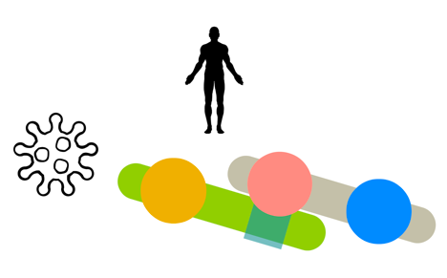
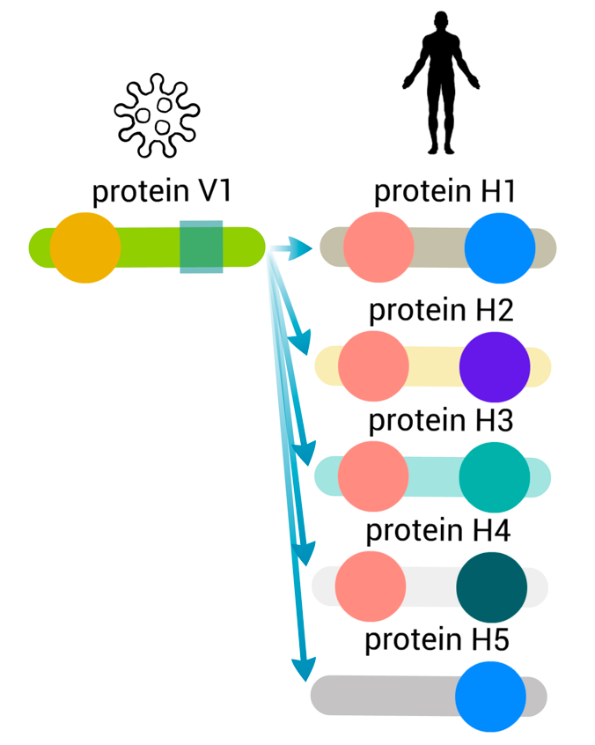


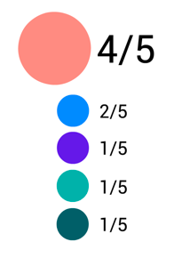

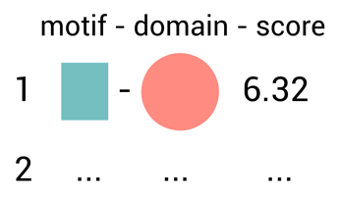

Overview
Globular
domains
1
We obtain protein
interaction data from
Linear
motif
We estimate which
domains are likely to
mediate interaction
3
2
We use to identify
known domains (sequence signature match)
We take interacting partners of
viral-interacting human proteins containing these domains and use QSLIMFinder to discover linear motifs de-novo
4
Benchmark based on known instances
and regions necessary to interact
and combine domain-motif pairs
5

Slide 3
Viral-interacting proteins appears as hubs: study bias

Slide 4
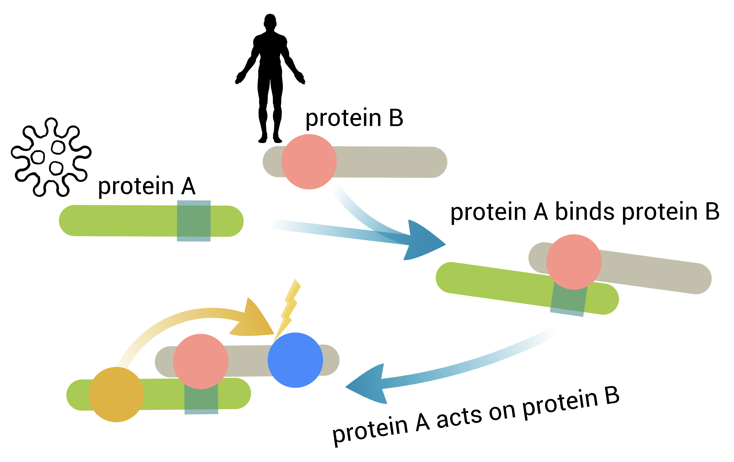
Identifying domains likely to mediate interaction
Author – Paper interaction
Paper – Topic interaction
- We want to find Author –Topic interactions
Viral protein – human protein interaction
human protein – human domain interaction
- We want to find Viral protein – human domain interactions
Viral protein might be binding human proteins with related functions: could not distinguish such preference from true binding domain

Slide 5
Method for estimating which domains are likely to bind viral proteins
How many human proteins should contain a domain of interest out of all proteins that interact with a specific viral protein so that we can say with % confidence (p-value) that a viral protein binds that domain.

Slide 6
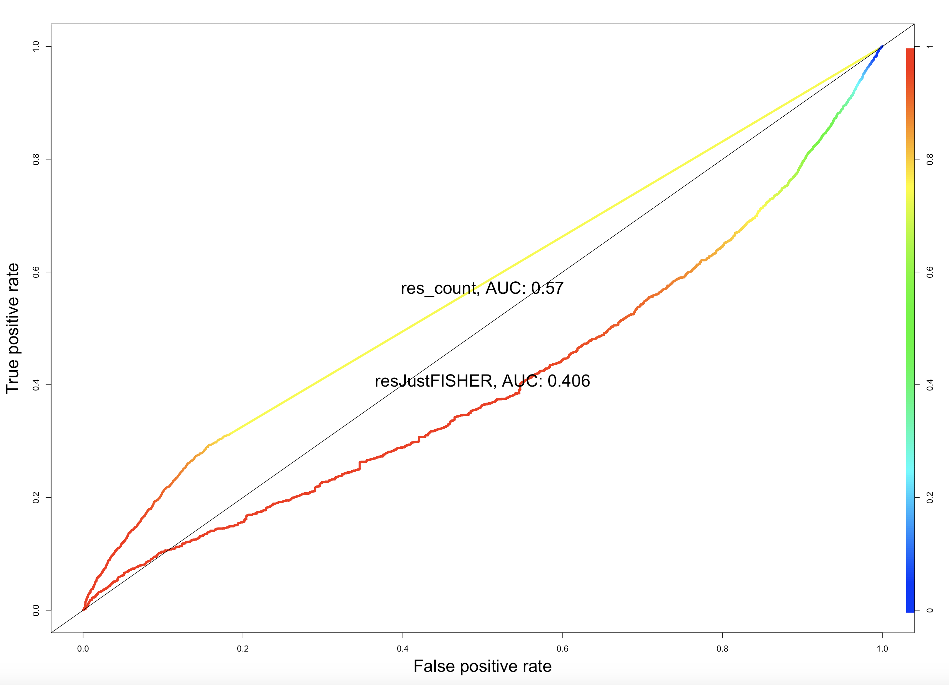
Domains likely to mediate interaction are enriched in ELM domains
Notes:
The description of the method:
How many human proteins should contain a domain of interest out of all proteins that interact with a specific viral protein so that we can say with % confidence that a viral protein binds that domain.
Reflects the association between the total number of human proteins the viral protein interacts with and the fraction of these proteins containing a specific domain (Fisher's exact test doesn't account for this).
The rationale is that the number of human proteins that should contain a domain of interest for us to say with % confidence that a viral protein binds that domain changes as a viral protein gains more interacting partners. In a viral protein has only one human partner we cannot possibly identify which of the domains in that single protein are mediating interactions. Our ability to identify this domain grows a the degree of viral protein grows.

Slide 7
Protein kinases and Zinc-finger proteins also identify domains enriched in ELM domains
ROC 2
ROC 1

Slide 8
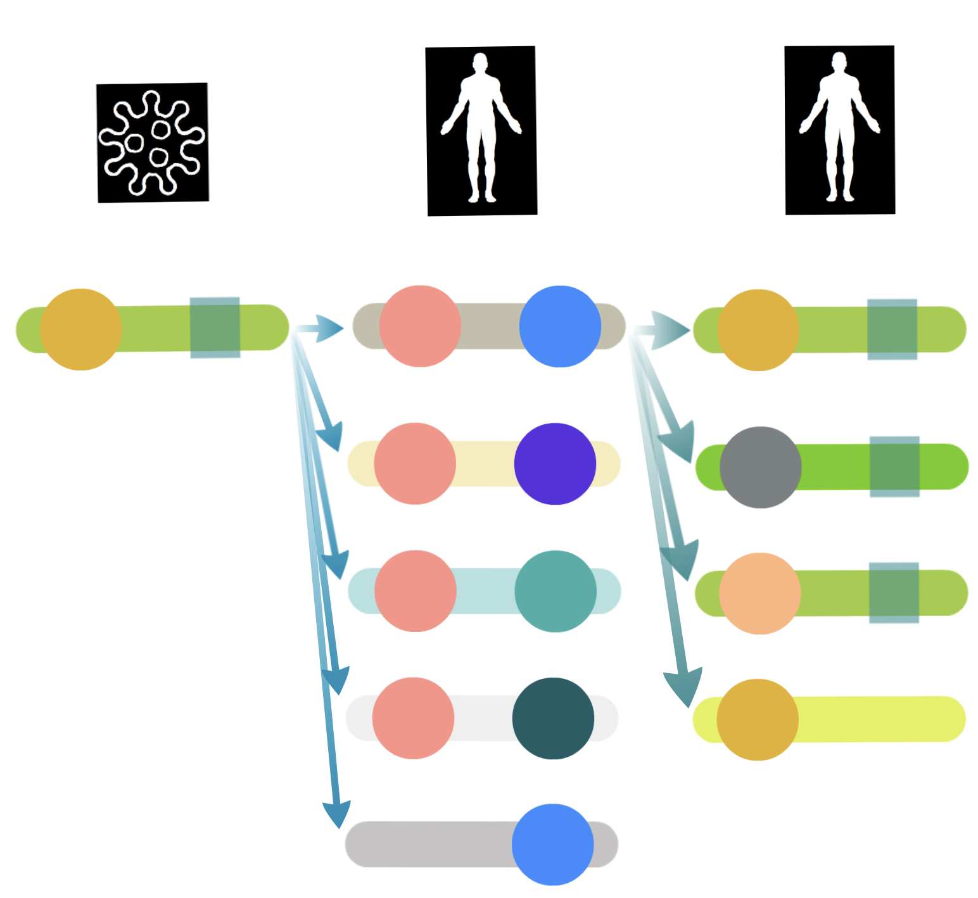
Motif search setup
QSLIMFinder: Palopoli & Edwards, 2015
3 networks:
Full IntAct data:
Only Vidal’s data (Y2H, in-vitro)
Only Mann’s data (AP-MS, in-cell-line)
Query
Protein-centered
Non-Query
Motif search dataset =
Query + Non-Query
proteins
Only motifs in query proteins can be de-novo discovered

Slide 9
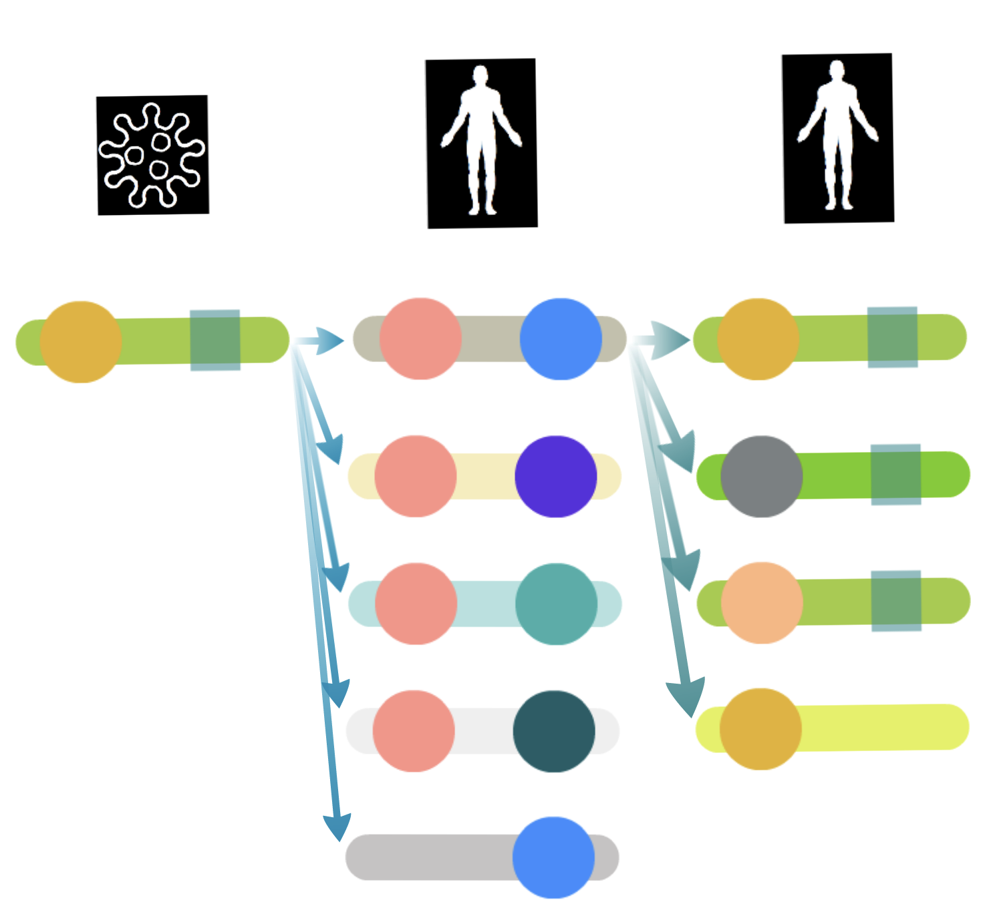
Evaluating performance
Query
Non-query
Query
Positive set: known linear motif instances from ELM DB
Negative set: random locations in the same proteins

Slide 10
All types of motifs

Slide 11
Domain-binding motifs MOD & LIG
fig

Slide 12
Domain-binding motifs MOD & LIG
fig
fig

Slide 13
Linear motif search results
Each set consists of viral and human interacting partners of a viral-interacting human protein and 1 viral protein used to limit the search space
Out of 5987 sets of proteins 682 sets returned 548 motif patterns and 3326 motif instances in 654 proteins. (the probability of finding each motif by chance < 0.3)
After the FDR correction and filtering at p < 0.05, 105 sets has returned 91 motif pattern and 810 motif instances in 197 proteins.
Most of these have some degree of similarity with known motifs

Slide 14
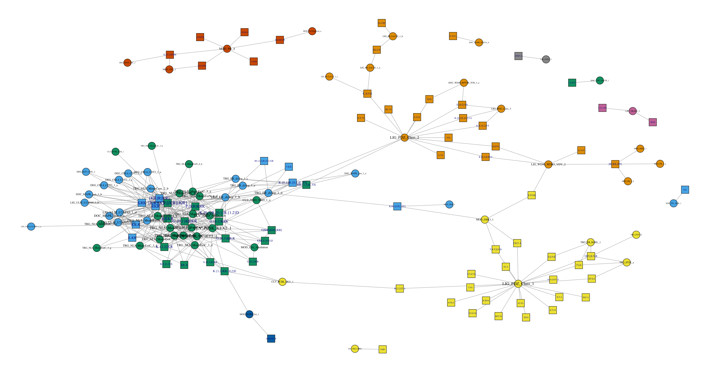
Linear motif search results
Notes:
Squares are motifs

